Slide 1


Malicious Honeypot
Team Members: Nick Marquardt (marquans@mail.uc.edu), John Velten (veltenjr@mail.uc.edu),
Advisor: Dr. John Franco (franco@ucmail.uc.edu)

Slide 2
Goals
This project is an exploratory study in the realm of cybersecurity. Honeypots are tools that are widely used to learn about, track, and prevent threats to a system. Attackers are baited with a phony system and from here they can be blocked, or just tracked. Our goal is to implement a honeypot that can do all these things, but also return malicious code that will allow us to gain access to and control the attacker’s system.

Slide 3
Intellectual Merits
A honeypot has traditionally been used for passive observation or defense of a computer system. Our take to create a more active honeypot that will return malicious code to an attacker seems to be unique and interesting for our group to pursue. Our project will help us to understand how traditional honeypots work and how to practice ethical hacking.

Slide 4
Broader Impacts
The impact of having a malicious honeypot ranges widely. On one side, it would deter attackers more and make it easier to setup adequate defenses for a system. On the other side, there would have to be a closer look at the legality of what could be done to a malicious attempt to gain access to the system. Future laws would have to be created to help balance the affect a malicious honeypot would have.

Slide 5
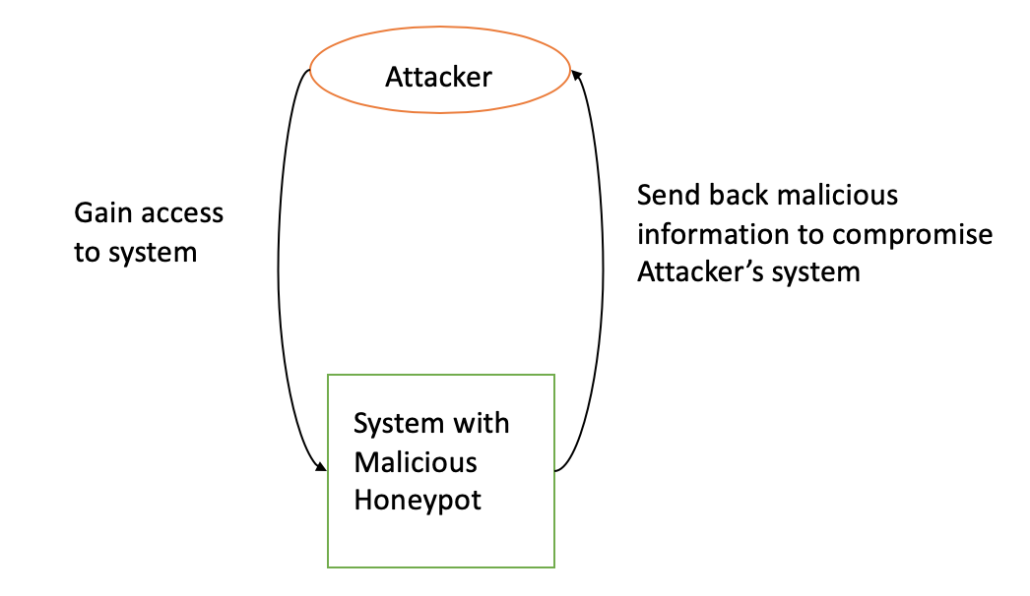
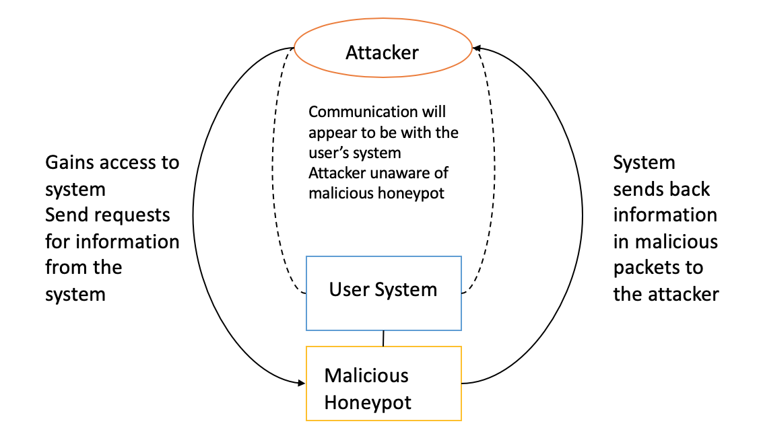
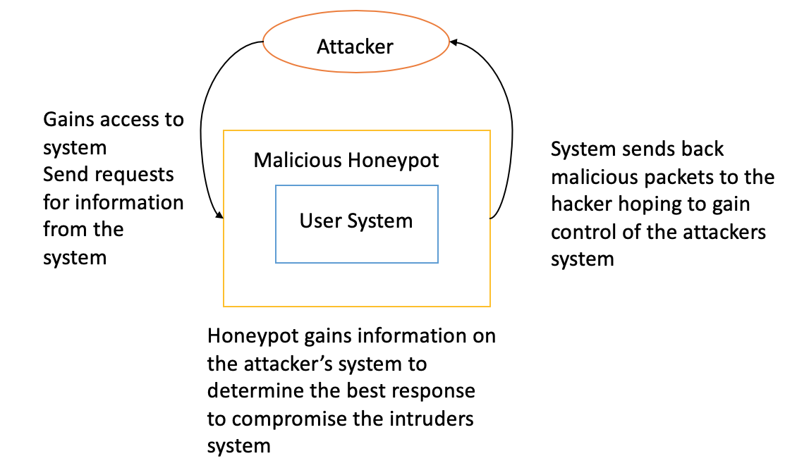
Design Diagrams
Level 0
Level 1
Level 2

Slide 6



Technologies
Raspberry Pi hosting SSH server
Secure shell protocol to connect to remote computers will enable hackers to detect and access the server
Server logs activity of user
Commands and results are logged and parsed to analyze how attacker is gaining access to system
Packet sniffing
Using “tcpdump” and Wireshark, more info will be gathered on the attacker’s intentions
Spoof commands
Typical commands run on Linux that will be masqueraded
They will appear to work normally, but will work differently in the background
Malicious PDFs
PDFs will be embedded with malicious code and placed on the server
They will be accessible to anyone unfortunate enough to download them

Slide 7
Milestones
28 Feb.
Logging and packet sniffing
Have all tracking functionality in place to analyze server sessions
3 June
Alert system
Have system in place to alert administrators when there is unauthorized activity on server
13 Mar.
Malicious PDFs
Create 1 or 2 PDFs with malicious code to place on the server and have them tested on a VM
20 Mar.
Spoof commands
Have a few basic spoof commands in place to take advantage of attacker
27 Mar.
More features

Slide 8
Results
Server up and running
Running SSH server from Raspberry Pi that can be accessed remotely
Can be accessed from unauthorized users when port is opened
Logging information
Authorization log is kept in auth.log
Logging commands and results of commands
Need to clean up the logs so they are more readable and easier to utilize for the user
Alert system
Admin is emailed if someone logs into server
Malicious PDFs
Researched, but not sure how to implement in a clever way yet
Spoof commands
Researched, but have not touched yet
Perhaps the most difficult part of the project

Slide 9


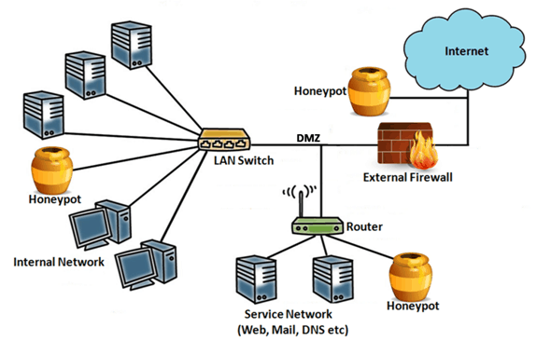
Challenges
Learning about honeypots
Had little experience with cybersecurity outside of the classroom, so we spent hours researching the topic on our own.
Linux scripting
Outside of the usual “cd” and “ls” there was significant ground to cover with scripting in Linux. This is an especially big deal when it comes to logging and packet sniffing.
Setting up the server
The server needed to be remotely accessible and run from an SSH terminal. Research needed to be done on how to enable SSH on a Raspberry Pi, how to use SSH on a local network, and finally how to use SSH remotely. Connecting to the server was the most difficult. A great deal of time was spent testing with each group member, friends, and others to see who could connect while outside of the LAN.

